Slide 1
Bandit-problem
David, Mads and Viktor
Group 1

Slide 2
Setup
4 bandits
2000 different sets of 4 bandits
1000 iterations each
10 bandits
2000 different sets of 10 bandits
1000 iterations each
Bandit initialization
Set mean within a specified range
Get reward based on mean + a random value in a specified range
Data saved to files and processed in matlab for evaluation

Slide 3
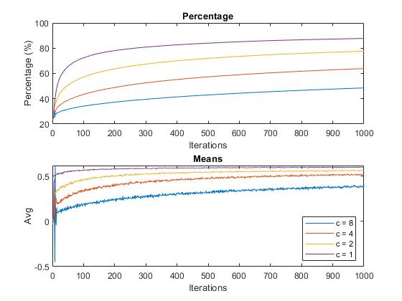
Results UCB

Slide 4
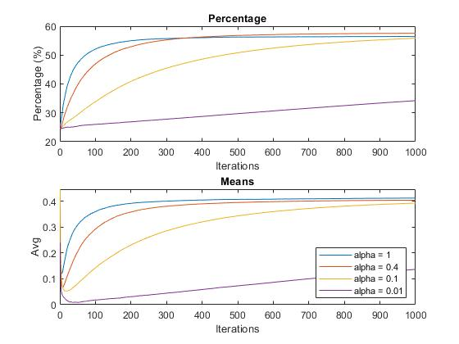
Results Gradient

Slide 5
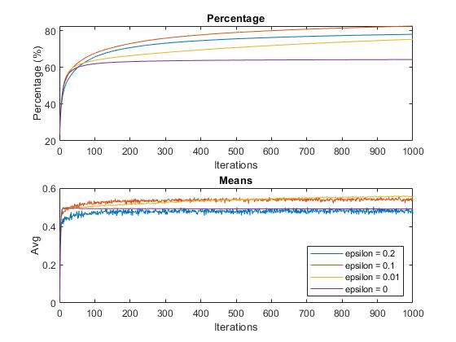
Results ε-greedy

Slide 6
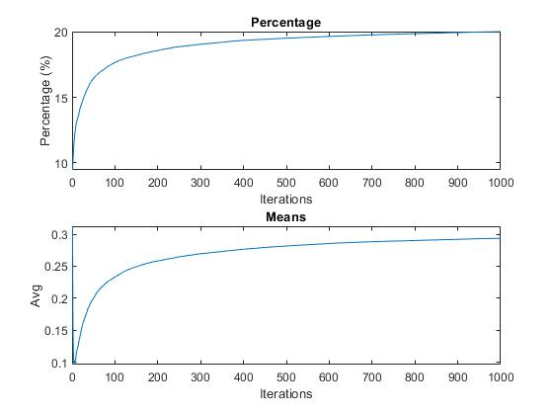
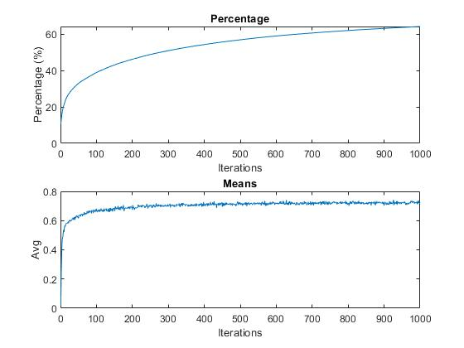
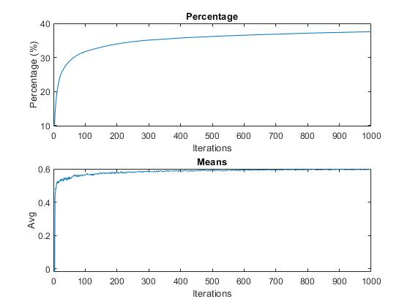

10 bandits
Gradient α = 1
ε-greedy $ε$ = 0.1
UCB c = 1

Slide 7
Conclusion
By increasing the number of bandits the algorithms had a harder time finding the right machine.
The epsilon-greedy method was the best in an increased number of bandits
For the ε-greedy algorithm with 4-bandits the best epsilon value was: 0.1
For the UCB algorithm with 4-bandits the best c value was: 1
For the gradient algorithm with 4-bandits the best alpha value was: 1

Slide 8
qLearning for robot-maze

Slide 9
Setup
3 Methods
qLearning(state s, double epsilon)
Epsilon-greedy
If not random
PickBestAction()
Else
PickRandom()
Update value based on action chosen.
One more method to PickBestAction() and one to find HighestValue()
Estimate[rows*columns][4] ->
Estimate[s.x + s.y * columns][i]
If action is impossible, it keeps trying a new one until a possible action is chosen.

Slide 10
Experimental Setup
Changed Field
Multiple Rewards / Traps
Bigger Field
More obstacles
Number of episodes
Different learning rates (α)
Different cost-values (γ)
Different epsilons (ε)
Change policy

Slide 11






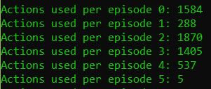

Results
Changed alpha
Epsilon: 0.1
Alpha: 1
Gamma: 0.9
Episodes: 100000
Epsilon: 0.1
Alpha: 0.4
Gamma: 0.9
Episodes: 1000
Changed gamma
Epsilon: 0.1
Alpha: 1
Gamma: 0.5
Episodes: 1000
Epsilon: 0.1
Alpha: 1
Gamma: 0.1
Episodes: 1000

Slide 12
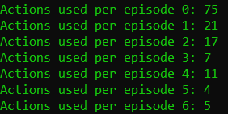



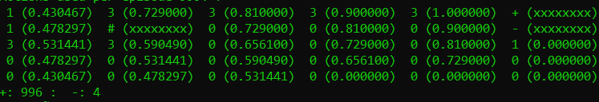
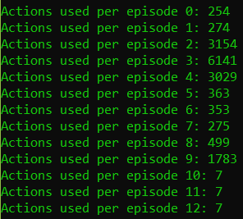
Results
Changed epsilon
Epsilon: 0.5
Alpha: 1
Gamma: 0.9
Episodes: 1000
Epsilon: 0.05
Alpha: 1
Gamma: 0.9
Episodes: 1000
Bigger field
Epsilon: 0.1
Alpha: 1
Gamma: 0.9
Episodes: 1000

Slide 13
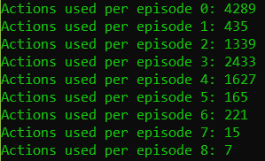
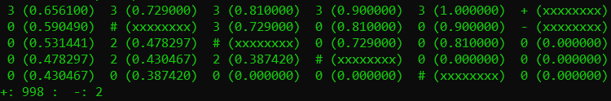
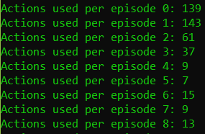
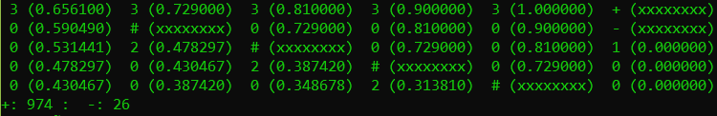
Results
Changed field, with more obstacles
Epsilon: 0.1
Alpha: 1
Gamma: 0.9
Episodes: 1000
Changed field, with more traps
Epsilon: 0.4
Alpha: 1
Gamma: 0.9
Episodes: 1000

Slide 14
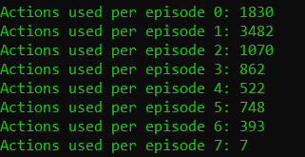

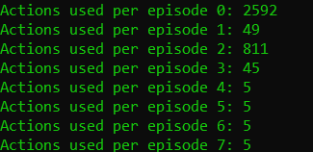

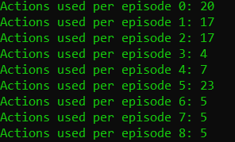

Results
More episodes
Epsilon: 0.1
Alpha: 1
Gamma: 0.9
Episodes: 10000
Epsilon: 0.1
Alpha: 1
Gamma: 0.9
Episodes: 100000
Changed Policy to explore if all surrounding areas are 0.
Epsilon: 0.1
Alpha: 1
Gamma: 0.9
Episodes: 1000

Slide 15
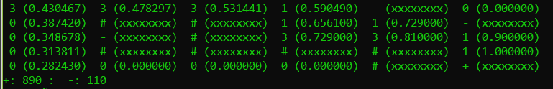
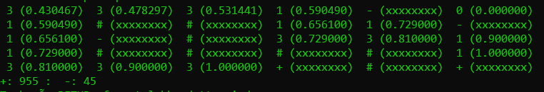
Results
Multiple traps along the way
Epsilon: 0.1
Alpha: 1
Gamma: 0.9
Episodes: 1000
Multiple rewards along the way
Epsilon: 0.1
Alpha: 1
Gamma: 0.9
Episodes: 1000

Slide 16
Conclusion
Changed Field
Multiple Traps – made it harder to find the reward
Multiple rewards –able to find both, depends on how it explores, but will always choose one when it learns
Bigger Field – more average actions, didnt change much – still succeeded
More obstacles (It always succeed, it just takes more time to learn the field).
Number of episodes – in case of this relatively simple task the algorithm learns quickly resulting in the non-existing need of many episodes. It affects the number of times et hits the mouse trap.
Different learning rates (α) – dosent effect much
Different cost-values (γ) – Changed the estimates of the actions in each state.
Different epsilons (ε) – faster learning, less times reached the cake
Change policy – faster learning based on more exploration

Slide 17
Backpropagation XOR

Slide 18
Setup
Two perceptrons in the hidden layer
One output perceptron
Two inputs
Weights are generated randomely
Sigmoid AF
Shuffleing of the array
Lenght of data array 1000 for training
Maximum nr. of epochs 10000
Testing with 4 different inputs a 1000 times

Slide 19
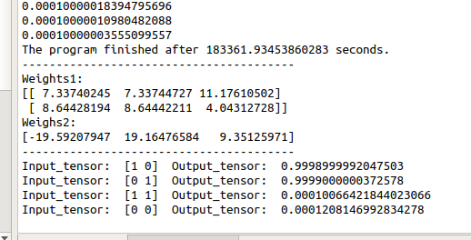
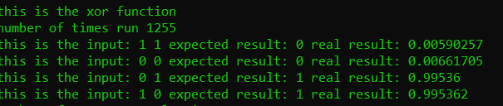
Results
With the sigmoid it would never reach exactly 1.
C++ code stopped after reaching an error of 0.000001 with a learning a rate of 0.1.
Python stopped after reaching an error of 0.0001 with learning rate 0.5.
Needs a check, to see if it in some tolerance to 1, to compare to the correct result.

Slide 20
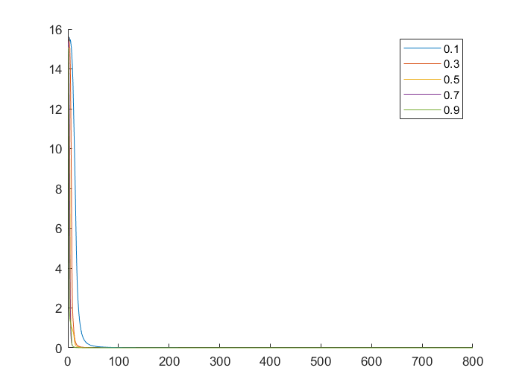
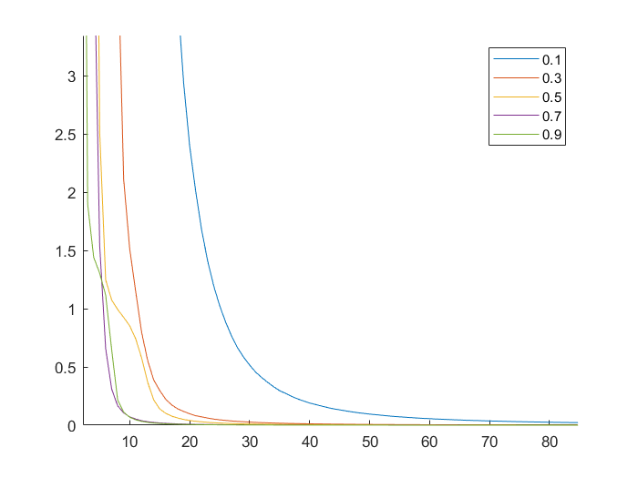
Results
Different learning rates
Sum of squared errors pr. epoch
0.1 : 8788 epochs
0.3 : 2912 epochs
0.5 : 1750 epochs
0.7 : 1272 epochs
0.9 : 986 epochs

Slide 21
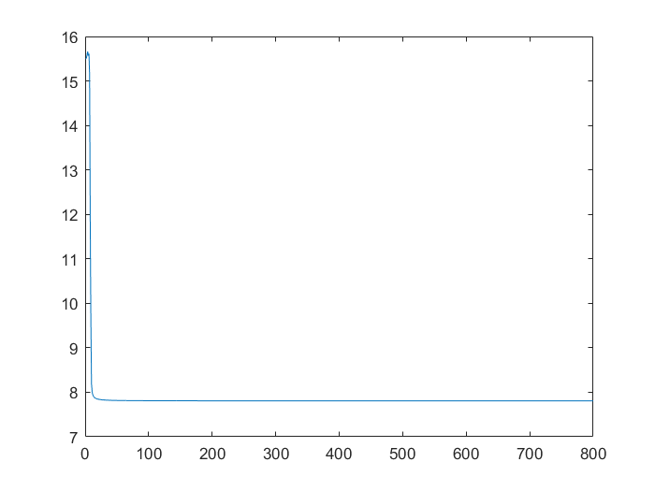
Conclusion
It was possible to teach a multilayer peceptron system to categorize the XOR-problem.
Due to the random generation of weights it will sometimes get stuck on a local minimum and therefore fails the training session.
Higher learning rate makes it learn faster.
Maybe TLU AF would have been better, due to the inputs
Plot of error stuck at a local minimum

Slide 22
Solution of the mountain car problem with SARSA

Slide 23
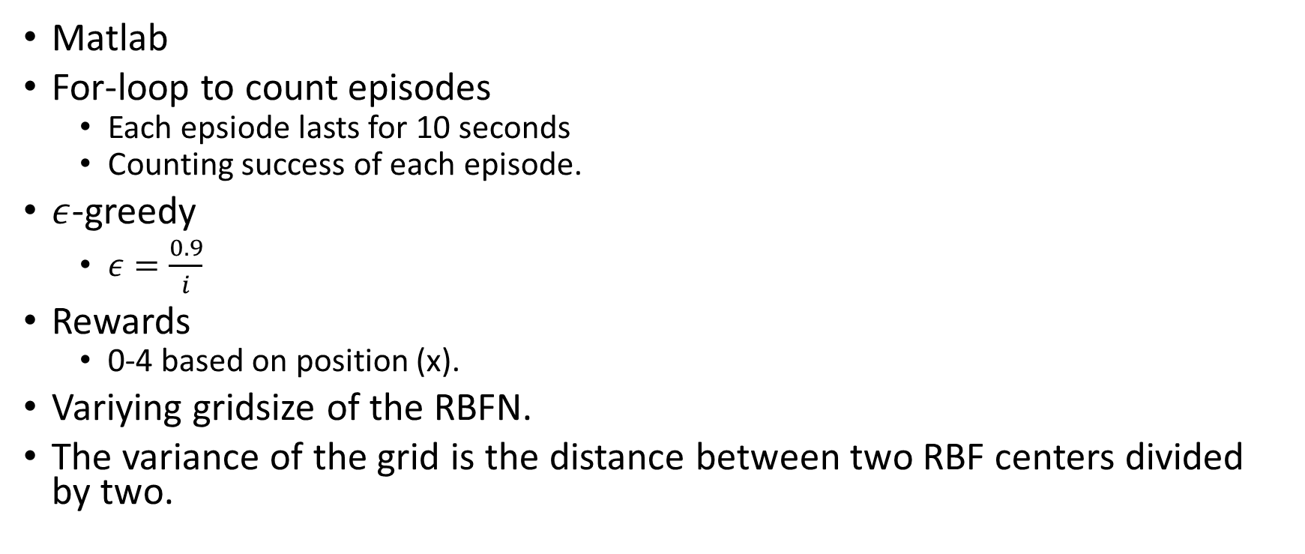
Setup
Matlab
For-loop to count episodes
Each epsiode lasts for 10 seconds
Counting success of each episode.
$ε$-greedy
$ε=\frac{0.9}{i}$
Rewards
0-4 based on position (x).
Variying gridsize of the RBFN.
The variance of the grid is the distance between two RBF centers divided by two.

Slide 24
Testing
Smaller maximum acceleration
Learns slower
Different Learning Rate
Different Grid Size

Slide 25
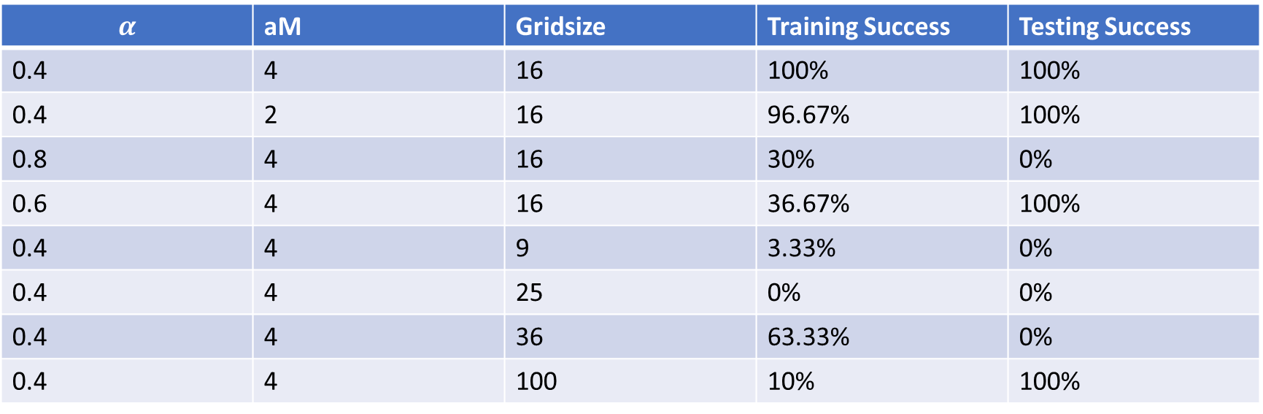
Results
Starting weights generated from same seed.
$ε$-greedy actions generated from unique seeds.
$$α$$ | aM | Gridsize | Training Success | Testing Success
0.4 | 4 | 16 | 100% | 100%
0.4 | 2 | 16 | 96.67% | 100%
0.8 | 4 | 16 | 30% | 0%
0.6 | 4 | 16 | 36.67% | 100%
0.4 | 4 | 9 | 3.33% | 0%
0.4 | 4 | 25 | 0% | 0%
0.4 | 4 | 36 | 63.33% | 0%
0.4 | 4 | 100 | 10% | 100%

Slide 26
Conclusion
Training succes does not necessarily have anything to do with testing percentage.
A check for correct answers in a row could stop this.
Bigger grid is not necessarily better for this problem.
Perhaps a higher exploration rate could solve this so more of the grid gets explored.
When encountering uneven grids, the algorithm fails to find a solution.

Slide 27
Video
https://youtu.be/9pJ0Lv5B7LM

Slide 28
Finite Differences Pendulum

Slide 29
Setup
6x6 RBFN
10 iterations with 0 gradient to terminate learning
Reward is based on time standing up
Roll-outs updates the current state and returns a reward based on the time the stick is standing up.
Weights are generated with the same seed each time.
Weights are updated after 36 roll-outs.
Starting angle is generated randomely between -20 and +20 degrees
Rollout temirnates after 10 seconds or if the angle is outside pi/7

Slide 30
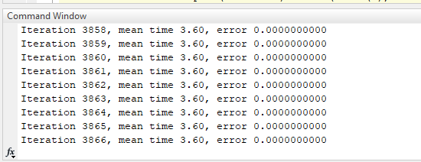
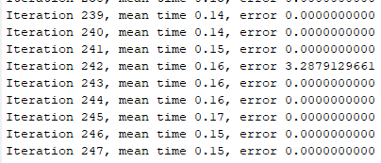
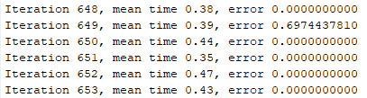
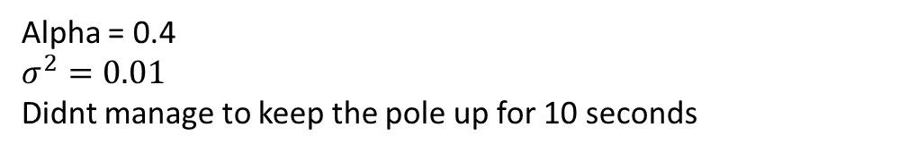
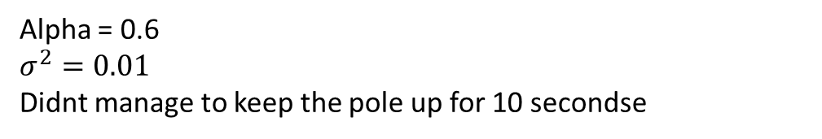
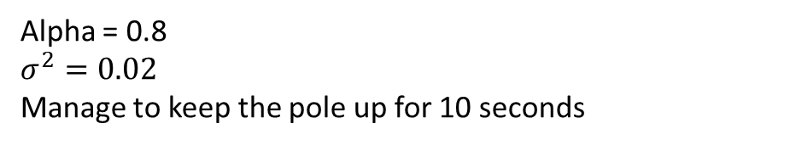
Results
Here the error is not the error, it is the norm
Alpha = 0.8
$$σ^{2}=0.02$$
Manage to keep the pole up for 10 seconds
Alpha = 0.4
$$σ^{2}=0.01$$
Didnt manage to keep the pole up for 10 seconds
Alpha = 0.6
$$σ^{2}=0.01$$
Didnt manage to keep the pole up for 10 secondse

Slide 31
Conclusion
Parameters could be more fine tuned.
Nr. of iterations could be lowered by doing so.
The way the reward is generated results in the pole not standing at 0 radians (upright), but a continous motion in one direction.
One way to solve this problem could be looking at the poles position in the reward function.
Minimizing the no fault area, could make the training for the algorithm easier.

